Slide 1

Design Patterns
A software design pattern is a solution to a particular problem you might face when designing an app’s architecture. But unlike out-of-the-box services or open-source libraries, you can’t simply paste a design pattern into your application because it isn’t a piece of code.
Rather, it’s a general concept for how to solve a problem. A design pattern is a template that tells you how to write code, but it’s up to you to fit your code to this template.

Slide 2
Design Patterns
Design patterns bring several benefits:
Tested solutions. You don’t need to waste time and reinvent the wheel trying to solve a particular software development problem, as design patterns already provide the best solution and tell you how to implement it.
Code unification. Design patterns provide you with typical solutions that have been tested for drawbacks and bugs, helping you make fewer mistakes when designing your app architecture.
Common vocabulary. Instead of providing in-depth explanations of how to solve this or that software development problem, you can simply say what design pattern you used and other developers will immediately understand what solutions you implemented.

Slide 3
Types of Design Patterns
#1 Creational
Creational software design patterns deal with object creation mechanisms. They try to instantiate objects in a manner suitable for the particular situation. Here are several creational design patterns:
Factory Method
Abstract Factory
Builder
Singleton
Prototype

Slide 4
Types of Design Patterns
#2 Structural
Structural design patterns aim to simplify the design by finding an easy way of realizing relationships between classes and objects. These are some structural architecture patterns:
Adapter
Bridge
Facade
Decorator
Composite
Flyweight
Proxy

Slide 5
Types of Design Patterns
#3 Behavioral
Behavioral design patterns identify common communication patterns between entities and implement these patterns. Behavioral design patterns include:
Chain of Responsibility
Template Method
Command
Iterator
Mediator
Memento
Observer
Strategy
State
Visitor

Slide 6
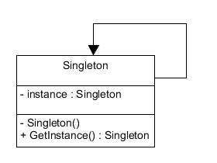
Singleton
Singleton

Slide 7
Singleton
The singleton pattern guarantees that only one instance of a class is instantiated.
Types Of Singleton
1. System Singleton
2. Custom Singleton

Slide 8
Singleton
System Singleton
// Shared URL Session
let sharedURLSession = URLSession.shared
// Default File Manager
let defaultFileManager = FileManager.default
// Standard User Defaults
let standardUserDefaults = UserDefaults.standard
// Default Payment Queue
let defaultPaymentQueue = SKPaymentQueue.default()

Slide 9
Singleton
Custom Singleton
Approach A:
class SingletonA {
static let sharedInstance = SingletonA()
init() {
print("AAA")
}
}

Slide 10
Singleton
Custom Singleton
Approach B:
class var sharedInstance: SingletonB {
struct Static {
static let instance: SingletonB = SingletonB()
}
return Static.instance
}

Slide 11
Singleton
Custom Singleton
Approach C:
class var sharedInstance: SingletonC {
struct Static {
static var onceToken: dispatch_once_t = 0
static var instance: SingletonC? = nil
}
dispatch_once(&Static.onceToken) {
Static.instance = SingletonC()
}
return Static.instance!
}
}

Slide 12
Singleton
Pros and Cons
Singletons hinder unit testing:
A Singleton might cause issues for writing testable code if the object and the methods associated with it are so tightly coupled that it becomes impossible to test without writing a fully-functional class dedicated to the Singleton.
Singletons create hidden dependencies:
As the Singleton is readily available throughout the code base, it can be overused. Moreover, since its reference is not completely transparent while passing to different methods, it becomes difficult to track.

Slide 13
Singleton
Example
https://github.com/senthilsns/Design-Patterns.git

Slide 14
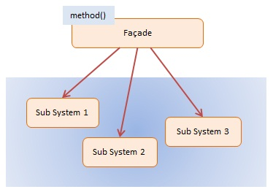
Design Patterns
Facade
Facade defines an simpler interface to an complex subsystem

Slide 15
Facade
Code Sample
Complex Subsystem
class Engine {
func produceEngine() {
print("prodce engine")
}
}
class Body {
func produceBody() {
print("prodce body")
}
}

Slide 16
Facade
Code Sample
Simple Interface
class FactoryFacade {
let engine = Engine()
let body = Body()
func produceCar() {
engine.produceEngine()
body.produceBody()
}
}

Slide 17
Facade
Code Sample
Usage
let factoryFacade = FactoryFacade()
factoryFacade.produceCar()
output
prodce engine
prodce body

Slide 18
Facade
Example
https://github.com/senthilsns/Design-Patterns.git

Slide 19
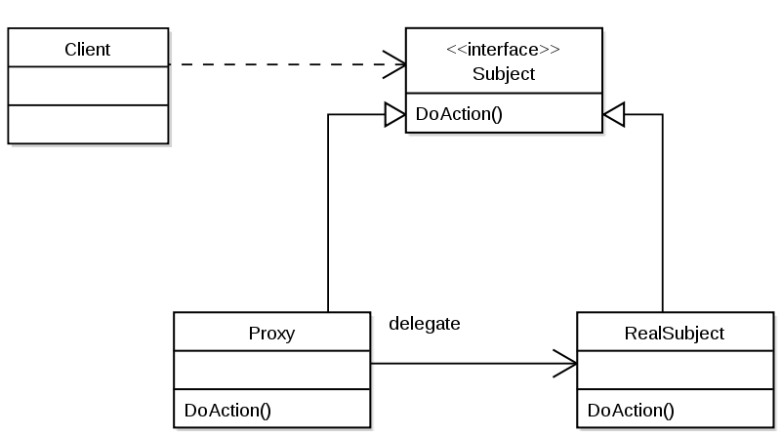
Proxy
Proxy is an object to help us to access another object. It simply delegates real job to that object or change its behavior.

Slide 20
Proxy
Code Sample
protocol Car {
func drive()
}
class Sedan: Car {
func drive() {
print("drive a sedan")
}
}

Slide 21
Proxy
Code Sample
class AutonomousCar: Car {
var car: Car
init(car: Car) {
self.car = car
}
func drive() {
car.drive()
print("by self-driving system")
}
}

Slide 22
Proxy
Code Sample
// Usage
let sedan = Sedan()
let autonomousCar = AutonomousCar(car: sedan)
autonomousCar.drive()

Slide 23
Proxy
Tips
Proxy pattern is popularly used in Cocoa which even has a specific NSProxy class in it.
Example
https://github.com/senthilsns/Design-Patterns.git

Slide 24
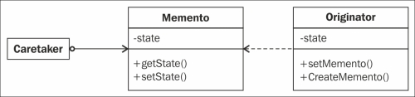
Memento Pattern
The role of the memento pattern is to capture an object's internal state and save it externally so that it can be restored later without breaking the encapsulation of this object.

Slide 25
Memento Pattern
Example
override func encodeRestorableState(with coder: NSCoder) {
coder.encode(fieldName, forKey: "fieldName")
//The above line should be repeated for all the required fields which can represent a state
//The value for fields will be restored and then the data from core data/ cloud kit or over the network can be fetched for these fields, if necessary
super.encodeRestorableState(with: coder)
}

Slide 26
Memento Pattern
override func decodeRestorableState(with coder: NSCoder) {
super.decodeRestorableState(with: coder)
fieldName = coder.decodeInteger(forKey: "fieldName")
fetchData(for: fieldName) //This method is used to fetch data for the current state.
self.scrollerView.reload() // reload the view if necessary.
}

Slide 27
Memento Pattern
Sample
https://github.com/senthilsns/Design-Patterns.git

Slide 28
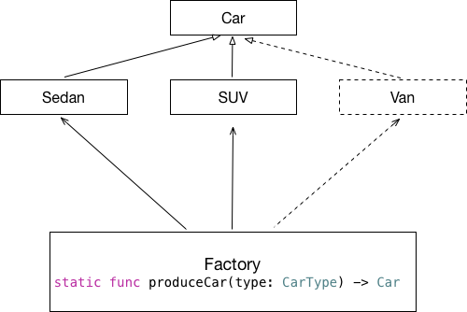
Factory
Factory methods to deal with the problem of creating objects without having to specify the exact class of the object that will be created.

Slide 29
Factory
Advantages
it helps loose coupling by separating init & usage logic
simple factory can be implemented in Swift using an enum and a switch-case
use a protocol if you are planning to return different objects (POP)

Slide 30
Factory
Example 1
class ColorFactory {
enum Style {
case text
case background
}
func create(_ style: Style) -> UIColor {
switch style {
case .text:
return .black
case .background:
return .white
}
}
}

Slide 31
Factory
Usage
let factory = ColorFactory()
let textColor = factory.create(.text)
let backgroundColor = factory.create(.background)

Slide 32
Factory
Example 2
protocol Environment {
var identifier: String { get }
}
class DevEnvironment: Environment {
var identifier: String { return "dev" }
}
class LiveEnvironment: Environment {
var identifier: String { return "live" }
}

Slide 33
Factory
class EnvironmentFactory {
enum EnvType {
case dev
case live
}
func create(_ type: EnvType) -> Environment {
switch type {
case .dev:
return DevEnvironment()
case .live:
return LiveEnvironment()
}
}
}

Slide 34
Factory
Usage
let factory = EnvironmentFactory()
let dev = factory.create(.dev)
print(dev.identifier)
Example
https://github.com/senthilsns/Design-Patterns.git

Slide 35
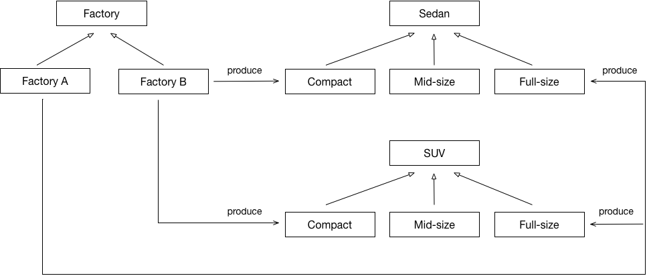
Abstract Factory
The abstract factory pattern provides a way to encapsulate a group of individual factories that have a common theme without specifying their concrete classes.It handles a little more complex use case.

Slide 36
Abstract Factory
Example
protocol Sedan {
func drive()
}
class FullSizeSedan: Sedan {
func drive() {
print("Mercedes-Benz CLA")
}
}

Slide 37
Abstract Factory
protocol SUV {
func drive()
}
class FullSizeSUV: SUV {
func drive() {
print("Lamborghini Urus")
}
}

Slide 38
Abstract Factory
protocol Factory {
func produceSedan() -> Sedan
func produceSUV() -> SUV
}
class FactoryA: Factory {
func produceSedan() -> Sedan{
return FullSizeSedan()
}
}

Slide 39
Abstract Factory
class FactoryB: Factory {
func produceSUV() -> SUV {
return FullSizeSUV()
}
}
Usage
let factoryA = FactoryA()
let fullsizeSedan = factoryA.produceSedan()
fullsizeSedan.drive()
let factoryB = FactoryB()
let fullsizeSUV = factoryB.produceSUV()
fullsizeSUV.drive()

Slide 40
Abstract Factory
Sample
https://github.com/senthilsns/Design-Patterns.git

Slide 41
Observer
Observer pattern, one object notifies other objects of any state changes.
The objects involved don't need to know about one another - thus encouraging a decoupled design.
This pattern's most often used to notify interested objects when a property has changed.
The usual implementation requires that an observer registers interest in the state of another object. When the state changes, all the observing objects are notified of the change.
If you want to stick to the MVC concept (hint: you do), you need to allow Model objects to communicate with View objects, but without direct references between them. And that's where the Observer pattern comes in.

Slide 42
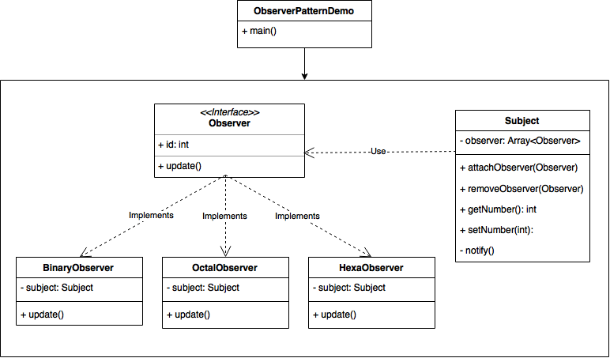
Observer

Slide 43
Observer
Types
Cocoa implements the observer pattern in two ways:
1. Notifications
2. Key-Value Observing (KVO).

Slide 44
Observer
1. Notifications
Notifications are based on a subscribe-and-publish model that allows an object (the publisher) to send messages to other objects (subscribers/listeners). The publisher never needs to know anything about the subscribers.
Notifications are heavily used by Apple. For example, when the keyboard is shown/hidden the system sends a UIKeyboardWillShow/UIKeyboardWillHide, respectively. When your app goes to the background, the system sends a UIApplicationDidEnterBackground notification.

Slide 45
Observer
Notifications are a simple and powerful way to send data in a loosely coupled way.
That is, the sender of a notification doesn't have to care about who (if anyone) receives the notification, it just posts it out there to the rest of the app and it could be picked up by lots of things or nothing depending on your app's state.
Example
(observer)
NotificationCenter.default.post(name: Notification.Name("UserLoggedIn"), object: nil)
(observable)
NotificationCenter.default.addObserver(self, selector: #selector(userLoggedIn), name: Notification.Name("UserLoggedIn"), object: nil)

Slide 46
Observer
KVO (Key-Value Coding)
It's an important concept of the Cocoa API. It allows objects to be notified when the state of another object changes.
Example
class sample {
var number :Int
init (number :Int) { self.number =number }
func incNumber() → Int {
return number++
}
}

Slide 47
Observer
Usage
let number = sample(20)
let num = number.incNumber()
Print (num) // 21
Example
https://github.com/senthilsns/Design-Patterns.git

Slide 48


